Slide 1
SOCIAL MEDIA, PRIVACY RIGHTS, AND IS BIG BROTHER REALLY WATCHING?
UTA CPE EVENT
AUGUST 10,2018
Charles Miller, Senior Lecturer
Charles D. Miller, P. C. cdmlaw@charter.net
(817) 879-5676

Slide 2
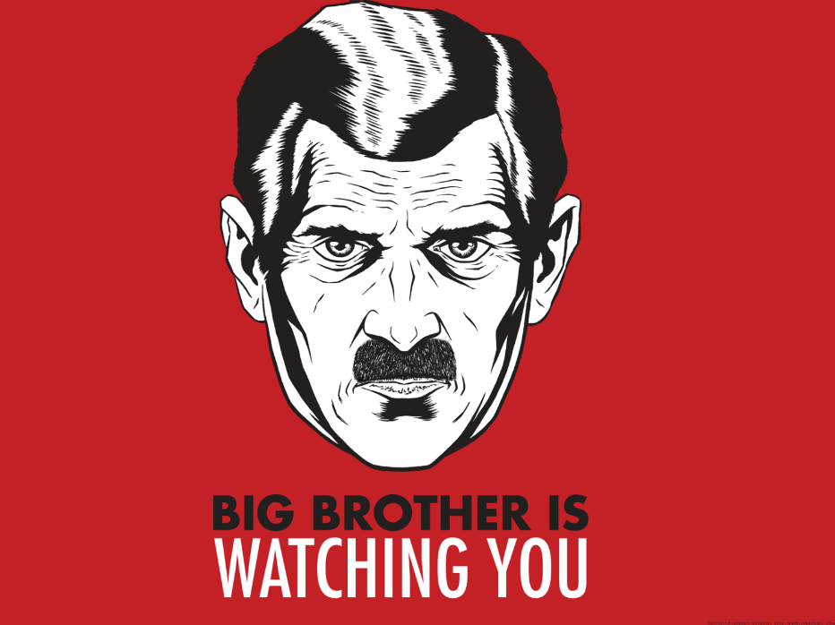
AGENDA
1) Social Media Today
2) Privacy Rights Law
3) Surveillance and Censorship
  “Big Brother” from 1984 by
  George Orwell
  China as “biggest brother of them all.”

Slide 3
DISCLAIMERS
Complex topics-much more than 50 minutes needed to cover each separately!
Thus-superficial treatment!
2017 CPE topic was employer right to monitor and discipline employee personal account activity. A few updates!
No coverage of HIPAA or related healthcare privacy rights
Focus is on Texas law

Slide 4

SOCIAL MEDIA PLATFORMS
Social Networking -Facebook, LinkedIn, Yammer, VK, QZone, Cloob
Video/content based communities - Youtube, Pinterest, Instagram
Blogs-Blogger, Twitter, Weibo, GroupMe.
Crowd-sourced projects-Wikipedia, Kickstarter, GoFundMe
Location-based communities-Foursquare, Yelp
Document–sharing sites - SlideShare, Scribd, Prezi

Slide 5
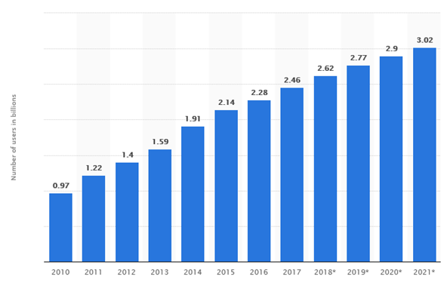
SOCIAL MEDIA USAGE
SOCIAL NETWORKING USERS FROM 2010 to 2021

Slide 6

SOCIAL MEDIA AND EMPLOYMENT LAW
Social media now affects virtually every workplace
Social media presents legal risks before, during and after employment
Use of Employee Social Media
  Employer use to screen employees (pre-employment)
  Employer restrictions on employee use of social media
  Employer’s own internal social media policy

Slide 7

#1 PRE-EMPLOYMENT CONCERNS
You can learn a lot from social media:
  Verify application information
  Ability to interact with others
  Judgment
What could go wrong?

Slide 8
RISKS OF “SCREENING”
Exposure to discrimination claims
  Decision maker cannot “unsee” information about race, age, religious beliefs, disabilities, etc.
  Exposure to protect characteristics not readily obvious, such as marital status, family restrictions, transgender transition, etc.
  Exposure to protected “off-duty” activities.
Accuracy and authenticity
  Cannot verify that the social media is posted by the applicant.

Slide 9

HIRING PROCESS - CYBER-SLEUTHING AND SOCIAL MEDIA SCREENING
Minimizing risks associated with social media screening
Look at social media content later in the interview process.
Use a screening system e.g. who, which sites, reports?
Hire 3rd party, written policy, keep records.

Slide 10

#2 EMPLOYEE SOCIAL MEDIA USE
Can an employer monitor an employee’s social media activity?

Slide 11
EMPLOYEE SOCIAL MEDIA ACTIVITY
Social media snooping
Is it OK to snoop into someone else’s private social media posts? (No!)
OK to use publicly available information.
Three influential cases
Konop (9th Cir.) - The federal Wiretap Act does not apply to access of secured websites because it only covers interceptions of information that is being contemporaneously transmitted.

Slide 12
EMPLOYEE SOCIAL MEDIA ACTIVITY
Pietrylo (DNJ) - Restaurant managers violated federal Stored Communications Act and New Jersey equivalent by coercing employees into giving access to private MySpace group page without authorization.
Ehling (DNJ) - Employer did not violate Stored Communications Act or National Labor Relations Act (NLRA) where employee wrote private Facebook post critical of employer and Facebook friend saw the post and freely reported it to the employee’s manager as an authorized user.

Slide 13
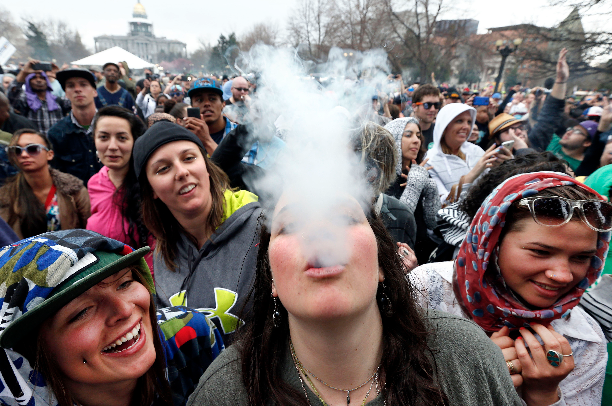
WHAT IF YOUR EMPLOYEE POSTED THIS ON FACEBOOK?
Can you rely on it taking adverse employment actions?

Slide 14
OFF-DUTY CONDUCT LAWS
Twenty-nine states and Washington D.C. have some form of law protecting off-duty conduct.
California prohibits employer from taking any job-related action for off-duty conduct.
Colorado: Illegal to terminate for off-premises, non-work time conduct if lawful activity unless:
  1) Rationally related to employee activities/duties
  2) Avoid appearance of COI with employer
Comments? Experience?

Slide 15
OFF-DUTY CONDUCT LAWS
In Texas, could terminate girl because use of marijuana is not permitted.
  Failing to take remedial action could lead to a claim for negligent hiring or retention against the employer down the road.
Other states do not foreclose an employer from taking adverse actions based on lawful conduct that occurs after hours and offsite.
  E.g. Michigan, Pennsylvanie
Answer may vary depending on state.
Consistency…important

Slide 16

EMPLOYEE SOCIAL MEDIA USE
Is inconsistent application of social media policy evidence of discrimination?

Slide 17
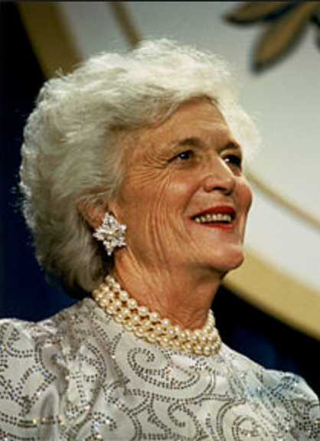
“HAPPY THE WITCH IS DEAD”
California State University ( Fresno)
Professor Randa Jarrar posted on personal Twitter
“Barbara Bush was a generous and smart amazing
racist who with her husband raised a war criminal.”
“Happy the witch is dead.”
Online outrage
“I work as a tenured professor.” ”I will never be fired.”
Posted a telephone number which was crisis suicide prevention center
University issued apology

Slide 18
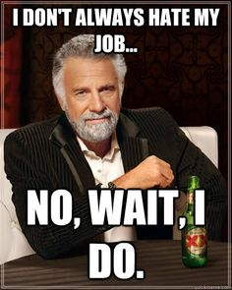

EMPLOYEE SOCIAL MEDIA USE
Can you take action against an employee who posts that he and his coworkers are “fed up” with their supervisor and the Company’s policies?

Slide 19
TRIPLE PLAY SPORTS BAR AND GRILLE (2d Cir. 2015)
Former employee posted:
- employer “can’t even do the tax paperwork correctly!!! Now I OWE money . . . Wtf!!!”
Several other former employees also responded that they owe money, purportedly because of employer’s mistakes.
Current employee “liked” original comment and was fired for disloyal conduct.
NLRB found that pressing “like” on Facebook was protected activity under the NLRA.

Slide 20
TRIPLE PLAY TAKEAWAYS
An employee’s negative comment online may not constitute disloyalty, especially if there is no mention of the employer’s products or services.
While an obscene comment made in the physical presence of customers may cause an employee to lose her NLRA protections, a similar comment made on social media may remain protected, even if customers view the social media comment.
Employers should continue exercising caution to avoid drafting overly broad social media policies.

Slide 21

FEDERAL TRADE COMMISSION (“FTC”)
In 2009, the FTC updated its Guides Concerning the Use of Endorsements and Testimonials in Advertising.
FTC released updated Dot Com disclosures in 2013.
Employers may find themselves facing an FTC enforcement action based on their employee’s online activities.

Slide 22
FEDERAL TRADE COMISSION REGULATIONS
Disclosure must be clear and conspicuous.
Disclosure must be of typical results.
Employees must disclose clear connection.
When do “endorsements” by employees become deceptive?

Slide 23

SOCIAL MEDIA SOLICITATIONS
Can posting on social media constitute solicitation of customers or employers in violation of an individual’s non-solicitation agreement with a former employer?

Slide 24
CORPORATE TECHS., INC. V. HARNETT (1st Cir. 2013)
Employment Agreement prevented employee “‘soliciting, diverting or enticing away” existing [CTI] customers or business’.
Employee left after a year and sent out a blast email that announced his new place of employment to a targeted list of recipients, 40% of whom were (or had been) Corporate Tech customers.
Employee had numerous interactions with customers after initial contact.
Employee violated the Agreement because Employee’s conduct could be construed as “enticing” customers away from Corporate Tech.

Slide 25


NOVARTIS (ALCON) BUSINESS USE POLICY
Opening Novartis accounts on Facebook, Twitter, YouTube or any 3rd party platform.
  Youtube, Twitter, Facebook
Posting of content on a Novartis controlled Social Media platform
  Comments?
Any media allowing engagement and interaction with Novartis content.

Slide 26
SOCIAL SECURITY - PERSONAL USE POLICY
No SMA where you are SSA representative
Be careful to ever identify yourself as SSA employee.
Never respond to comments of SSA website.
Never comment to any comments or questions on any SMA, even if trying to help. Never secure.
If ever refer to any SSA matter after have identified yourself as employee, state “Any views I express here are my own and do not reflect policies or views, or position of SSA.” Never use SSA email, address on SMA.
No release of PII (personally identifiable information) of claimants
Hatch Act restriction on federal employee political/fundraising activities

Slide 27

FAMOUS NON-EMPLOYMENT CASE
April 2017
Harvard rescinded admissions offers to at least 10 high school students who had been accepted into Class of 2021
“Class of 2021” Facebook created by Harvard
Private chat room by admits-mocking sexual assault, reference to hanging of Mexican child as “piñata time”, Holocaust jokes, commenting that images of abused children were sexually arousing.

Slide 28
TEXAS-PRIVACY RIGHTS
Texas Constitution protects persons from “unreasonable intrusions” meaning protected from intentioned intrusion into private affairs, seclusion, or solitude.

Slide 29
TEXAS PENAL CODE (Sec. 16.06)
Misdemeanor if the “…person knowingly installs an electronic or mechanical tracking device on a motor vehicle owned or leased by another person…”
But a vehicle may be community property.
Case: Husband cannot install tracking device to follow wife around in “her car” since it is “their” car in marriage estate..

Slide 30
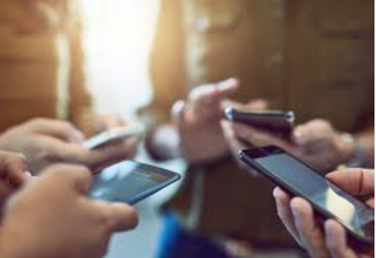
TEXAS PENAL CODE (33.02)
Misdemeanor/Felony: if “knowingly accesses a computer, computer network or computer system without the effective consent of the owner”
Cell phone = computer
Texas Harmful Access By Computer Act
Miller rejected community property
Held that a cell phone user/owner has “a great right to protection“ by using passwords and use on a daily basis.
Cell phone is NOT like a car!

Slide 31
TEXAS PENAL CODE (Sec. 16.02)
“…Cannot record in person communication where parties have reasonable explanation of privacy”
But one party can consent! You consent for all if you consent to recording of “your conversation.”
But if one caller outside of Texas, may differ.

Slide 32
TEXAS PENAL CODE (SEC. 32.51)
“It is a felony to obtain, possess, transfer, or use another person’s identifying information without consent …with intent to harm or defraud other person”
Name, SS#, DOB, Government ID

Slide 33
TEXAS PRIVACY ACT – (GOVERNMENT CODE 423)
Texas allows a civil action for “unmanned aircraft (drones) to capture on image of an individual or privately owned property in this state with the intent to conduct surveillance”
Also-Class C Misdemeanor

Slide 34
TEXAS PENAL CODE (SEC 21.15)
“Invasive visual recording”
“Cannot take an image without consent of female breasts, any intimate area, or another person in a bathroom or changing room”
Narrowed after 2011 case of Ronald Thomposn
Took 73 pictures of children at SeaWorld with focus on breasts and buttocks
“Improper photography”-Overruled by Supreme Court

Slide 35
PRIVACY RIGHTS
Release of personal data
Hacking; Target
European Union—General Data protection regulation
A client development “newsletter opportunity?”

Slide 36
CALIFORNIA CONSUMER PRIVACY ACT OF 2018
1. The right to know, through a general privacy policy, what personal information a business has collected about them, where it was sourced from, what it is being used for, whether it is being disclosed or sold
2. The right to “opt out” of allowing a business to sell their personal information to their parties
3. The right to have a business delete their personal information, with some exceptions
4. The right to receive equal service and pricing from a business, even if they exercise their privacy rights under the Act.

Slide 37
“BIG BROTHER”
China-leader is monitoring all computer/internet, texting, usage
Classic “surveillance” by government to internation, security and “security”
“Once untrustworthy, always restricted”

Slide 38
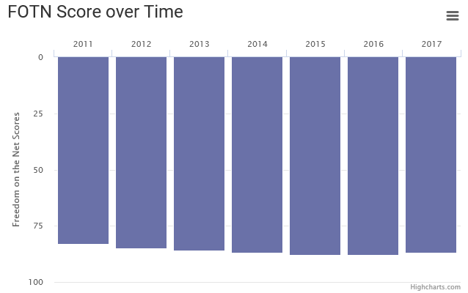
Censorship in China
Freedom on the Net 2017 Report:
Status = “Not Free”
Overall Ranking is 87/100
- Obstacles to Access: 17/25
- Limits on Content: 30/35
- Violations of User Rights: 40/40

Slide 39
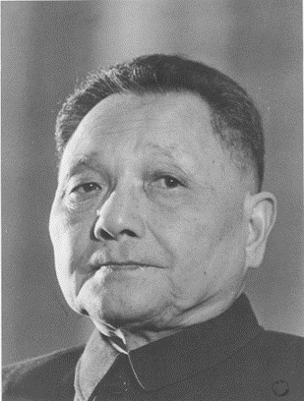
“THE GREAT FIREWALL OF CHINA”
Origin: Deng Xiaoping
- “if you open a window for fresh air for longer than 10 hours, you have to expect some flies to blow in”
“Golden Shield Project” (1998)
- database driven surveillance system
- allows government to access every person’s records
- delete content considered to be dangerous to Chinese government

Slide 40
LEGISLATION
Chinese government has created more than 60 different regulations
The Provisions on the Administration of Internet News Information Systems (2005)
Chapter III, Article 19 – restrictions not allowed online:
- violating the basic principles as they are confirmed in the Constitution;
- jeopardizing the security of the nation, divulging state secrets, subverting of the national regime jeopardizing the integrity of the nation’s unity;
- harming the honor or the interests of the nation;
- inciting hatred against peoples, racism against peoples, or disrupting the solidarity of peoples;

Slide 41
- disrupting national policies on religion, propagating evil cults and feudal superstitions;
- spreading rumors, disturbing social order, or disrupting social stability;
- spreading obscenity, pornography, gambling, violence, terror, or abetting the commission of a crime;
- insulting or defaming third parties, infringing on the legal rights and interests of third parties;
- inciting illegal assemblies, associations, marches, demonstrations, or gatherings that disturb social order;
- conducting activities in the name of an illegal civil organization

Slide 42
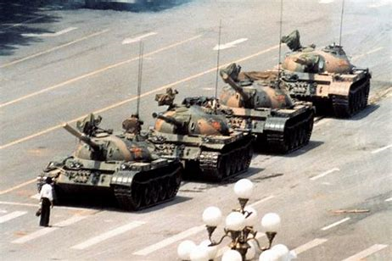
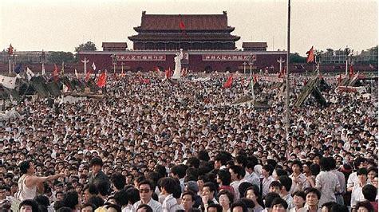
TIANANMEN SQUARE PROTESTS OF 1989
“July Fourth Incident”
Protest led by students – unhappy with economic development focusing towards the political elite
Over 1 million protestors
Martial Law – 300,000 troops; hundreds of Chinese citizens killed

Slide 43
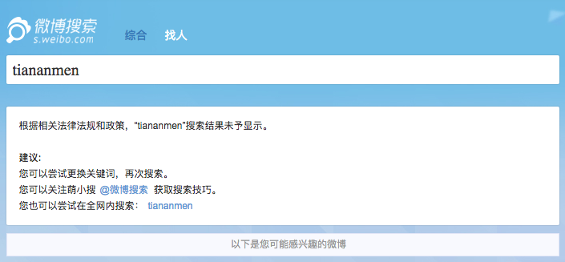
TIANANMEN SQUARE PROTESTS OF 1989
Censorship:
Any word related to protests were blocked
Error Message sent back:
“According to the relevant laws, regulations and policies, the search results of ‘fill in’ cannot be displayed”

Slide 44
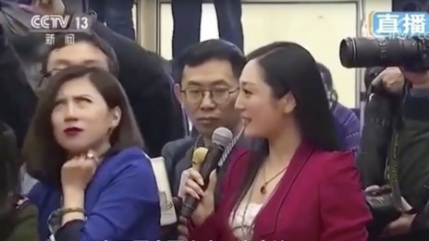
JOURNALIST EYE ROLL CONTROVERSY
March 13, 2018
The National People’s Congress
Video went viral in first couple of hours
Blocked “journalist in blue”
Reporter’s accreditation revoked
https://www.youtube.com/watch?v=UcryuTkyXDM

Slide 45
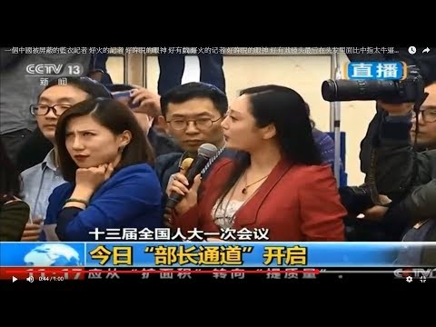

Slide 46
FINANCIAL CREDIT SYSTEM
US-FICO score evaluates credit worthiness by using private financial data carefully screened by statistics.
Introduced 1989—Praised as more objective, no “redlining.”!
2013—Alipay (Alibaba) entered into consumer credit evaluation
Recognized—No credit rating system, but 345,000,000 cellphones
Data collection, financial data translate to credit status

Slide 47
CHINA ANNOUNCES SOCIAL CREDIT SYSTEM
National blacklist of unpaid court fines
Violence against health care workers recorded
Illegal plastic surgery outfits
10 hours of video game lower credit score
Car rentals access
Skip line at Beijing Capital Airport if 750 score

Slide 48
MORE - BEING DEVELOPED IN PROCESS FOR 2020
Government prohibits disrupting or blocking check-in counters or airport corridors
Suzhou— bus fare, evasion presenting fake product review online, not paying elective bills
Blacklisting of people in “illegal social organizations” or NGOs.
Showcasing on data apps
Travel bans—airplanes, trains

Slide 49
THE END

